Slide 1
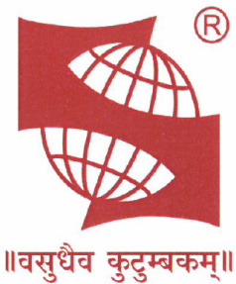

"Productivity Improvement through Line Balancing Technique and Manpower Optimization using APS and STDS Software“
Project Report
On
AT
GENERAL MOTORS INDIA PVT LTD
TALEGAON, PUNE
Under The Guidance of
Dr. ANAND KULKARNI
Symbiosis Institute of Technology
Mr. SANJAY RAINA
General Motors India Pvt. Ltd
BY
AISHWARY JAGETIA
13070121605
Notes:
We designed this template so that each member of the project team has a set of slides with its own theme where he/she can present their research. Members, here’s how you add a new slide to just your set:
Mark where you want to add the slide: Select an existing one in the Thumbnails pane, click the New Slide button, then choose a layout.
The new slide gets the same theme as the previous one you selected.
Careful! Don’t annoy your fellow presenters by accidentally changing their themes. That can happen if you choose a theme Variant from the Design tab, which changes all of the slides in your presentation to that look.

Slide 2

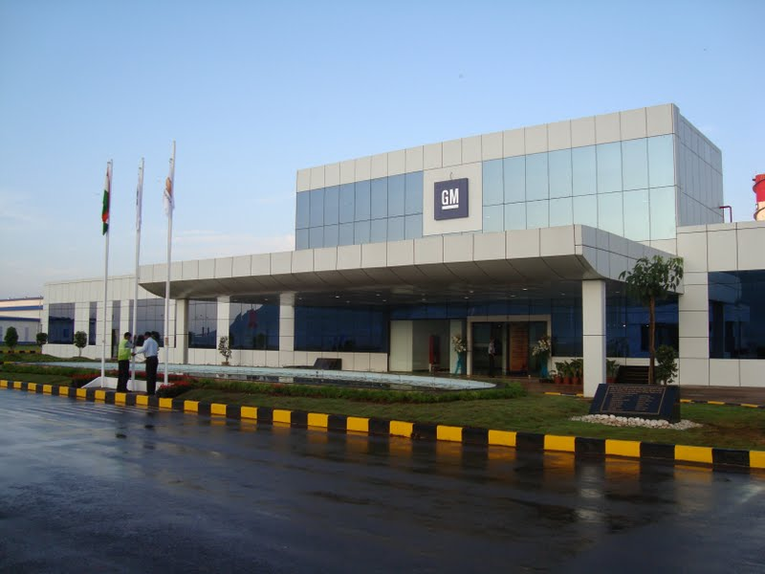

Introducing General Motors India Pvt. Ltd
"GM’s vision is to be the world leader in transportation products and related services. We will earn our customers’ enthusiasm through continuous improvement driven by the integrity, teamwork, and innovation of GM people."
Principles :
People Involvement
Standardization
Built - In Quality
Short Lead Time
Continuous Improvement
Vehicle Plant
Site area : 300 Acres
Start of production : Qtr-3 of 2008
Capacity : 1,40,000 units p.a
Management systems: GM-GMS
Automation level : Low-Medium
Automation level : Medium
Power Train
Site Area: 25 Acres
Start of production : Nov 2010
Capacity : 1,60,000 units p.a
Management systems: GM-GMS
Automation level : Low-Medium
M-300
SGM

Slide 3
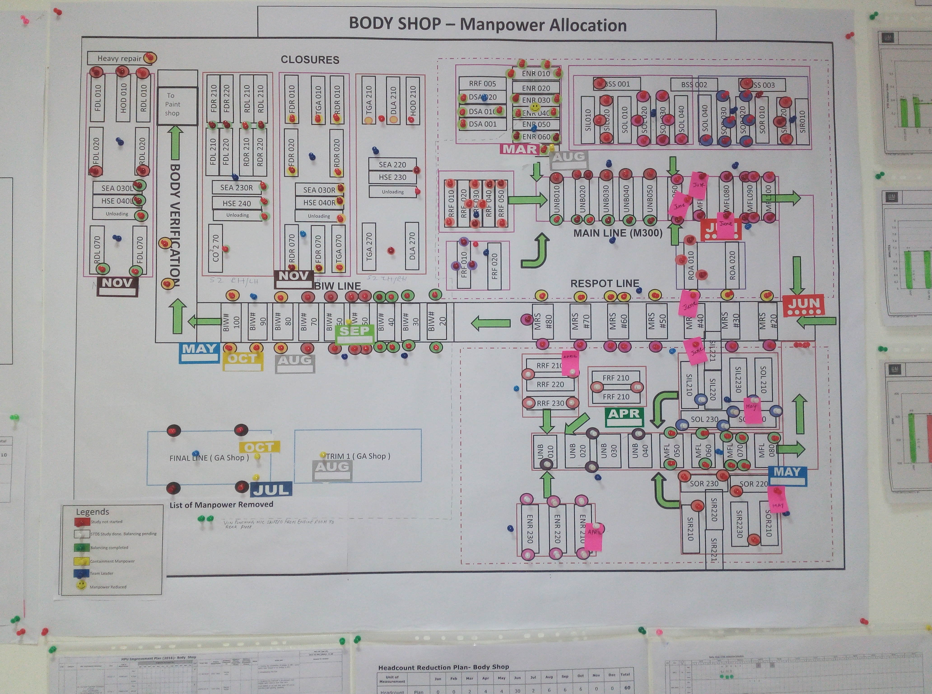
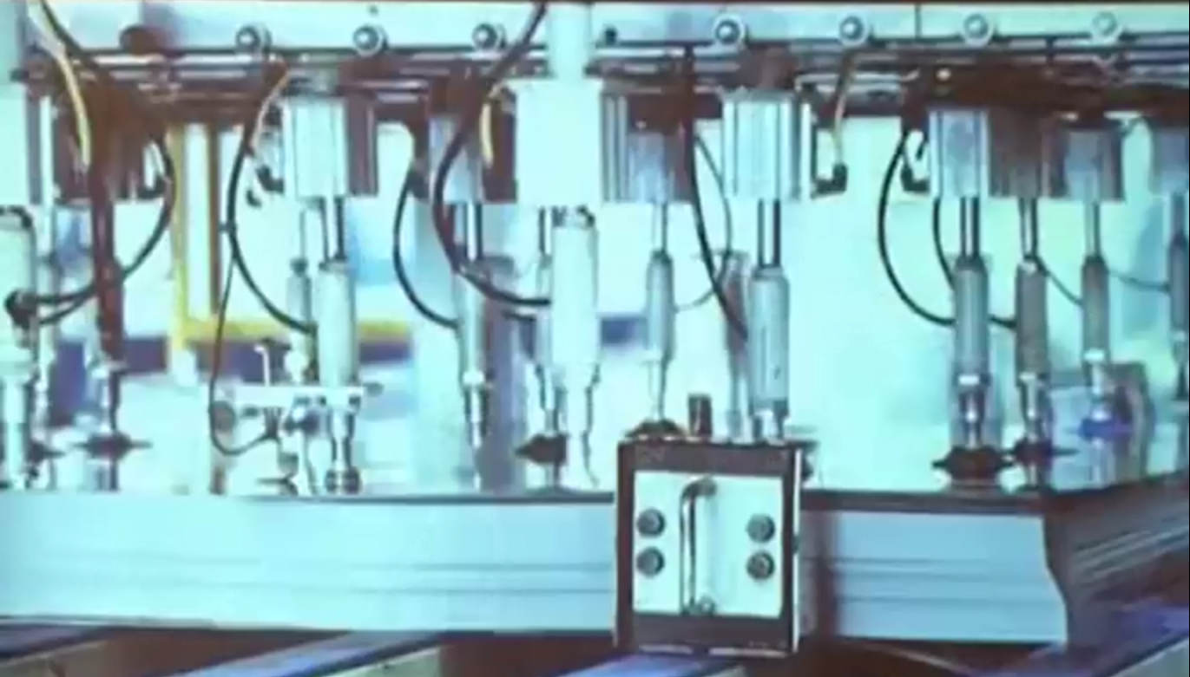
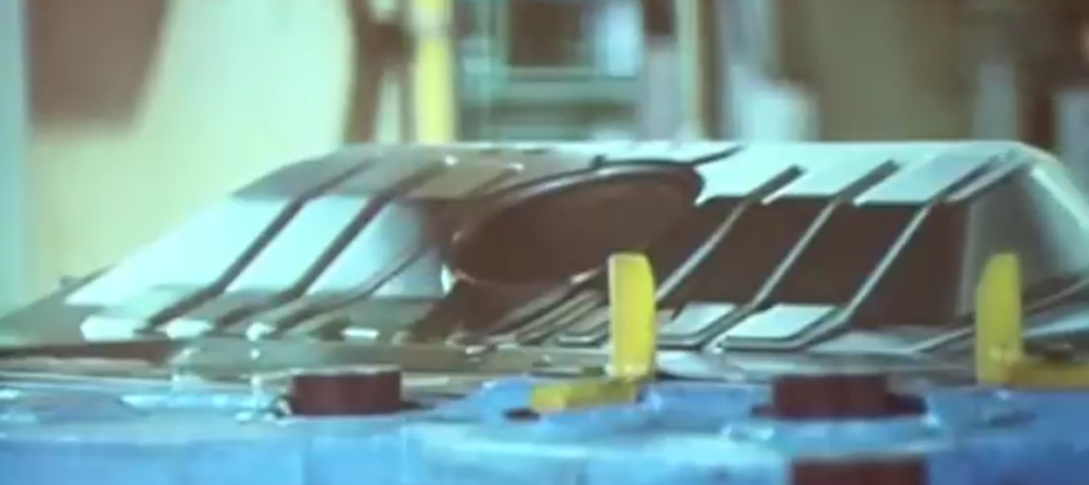
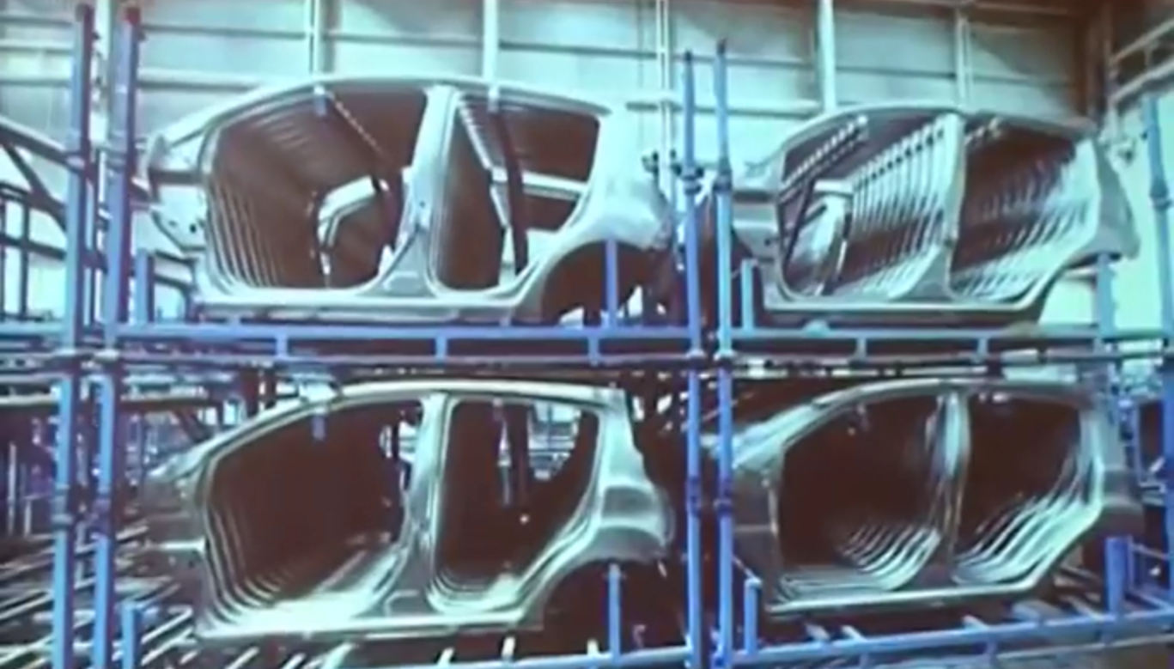
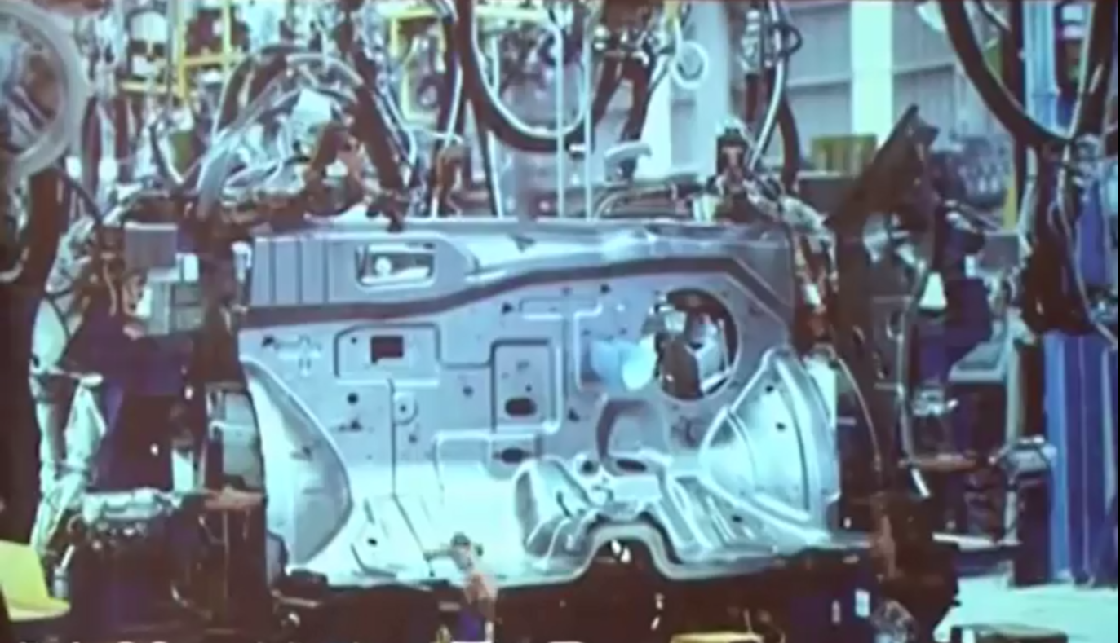
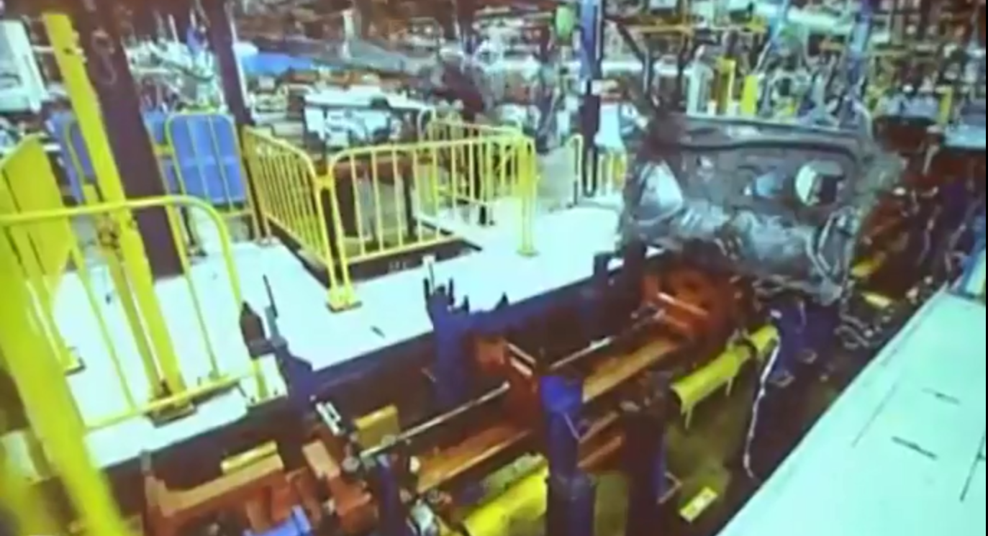
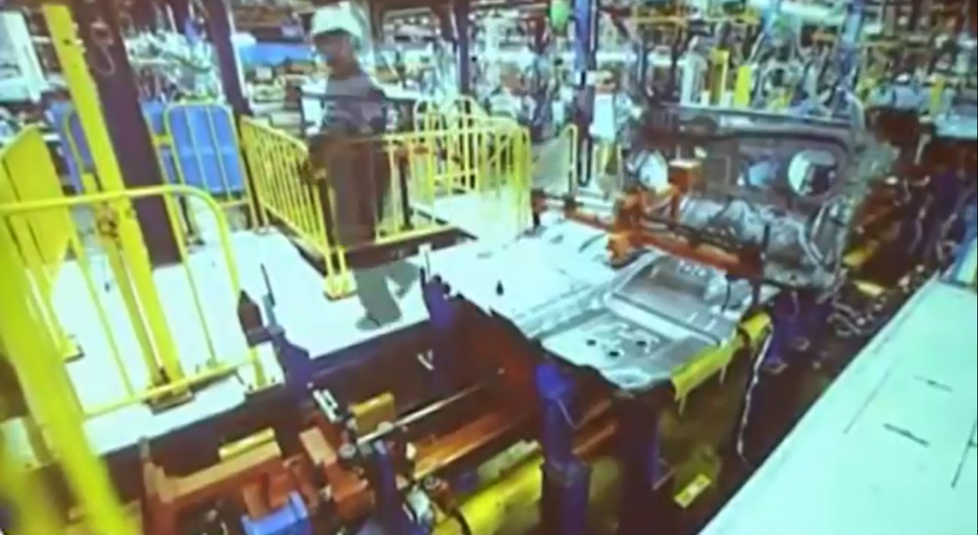
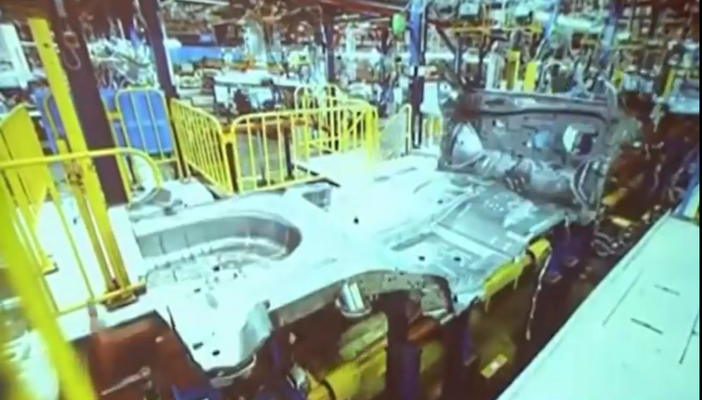
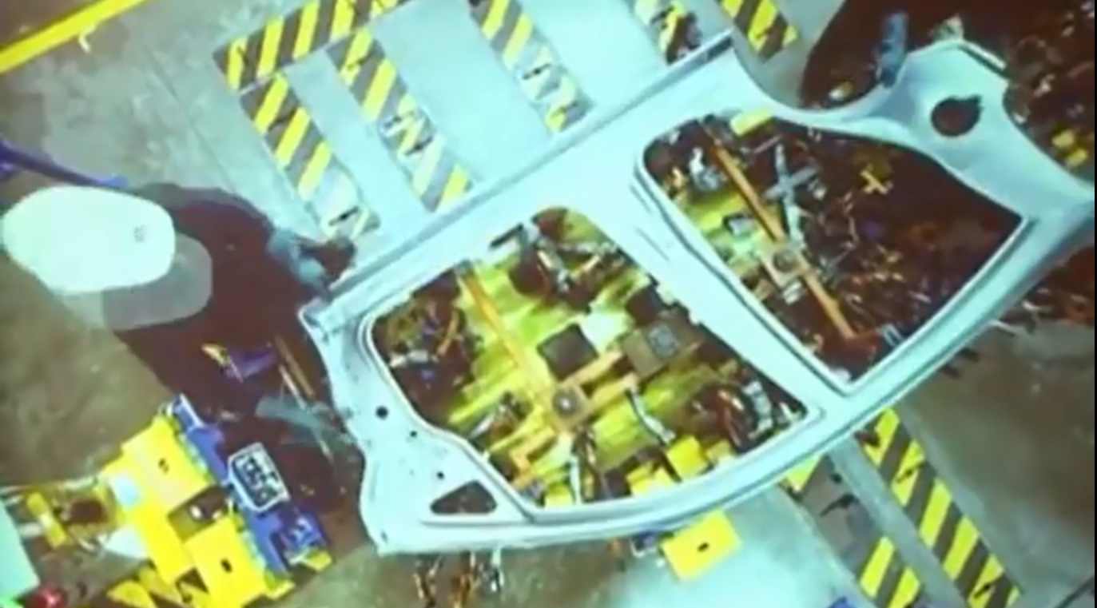
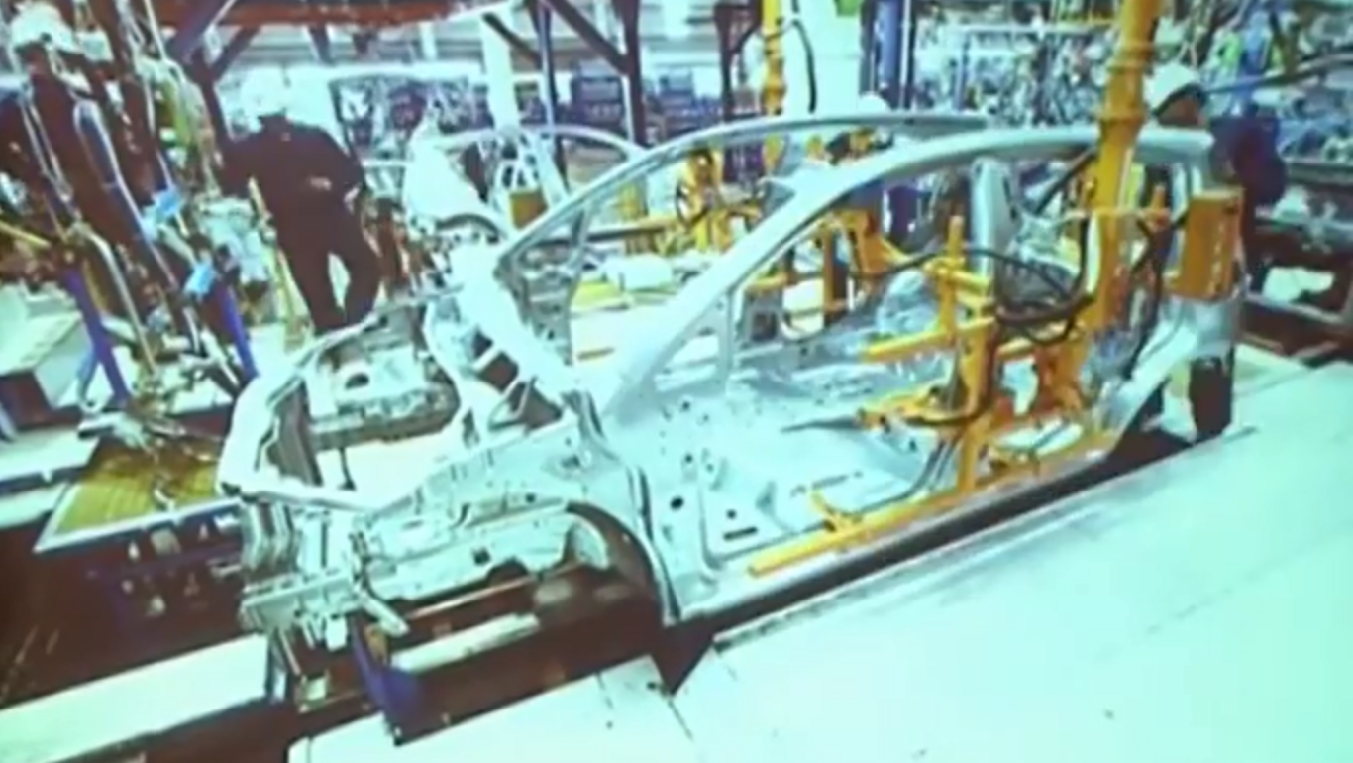
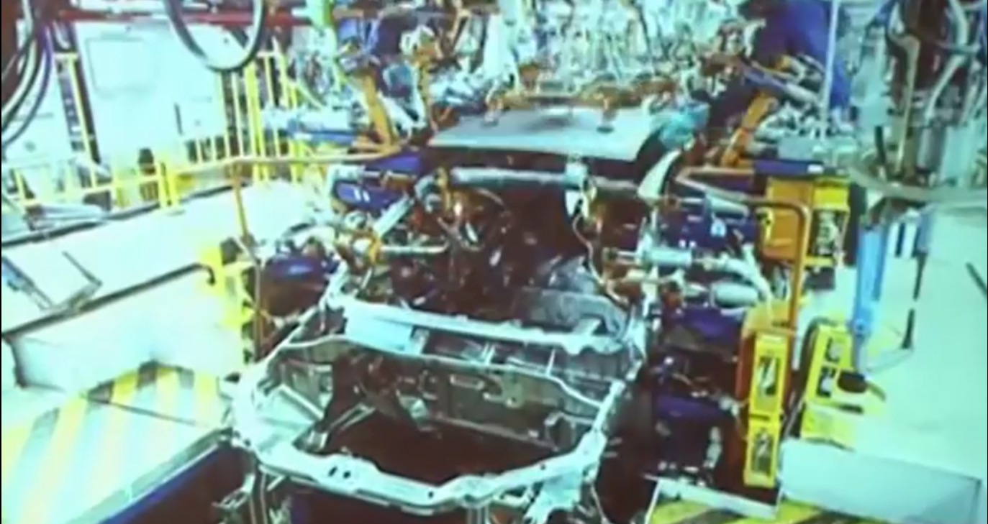
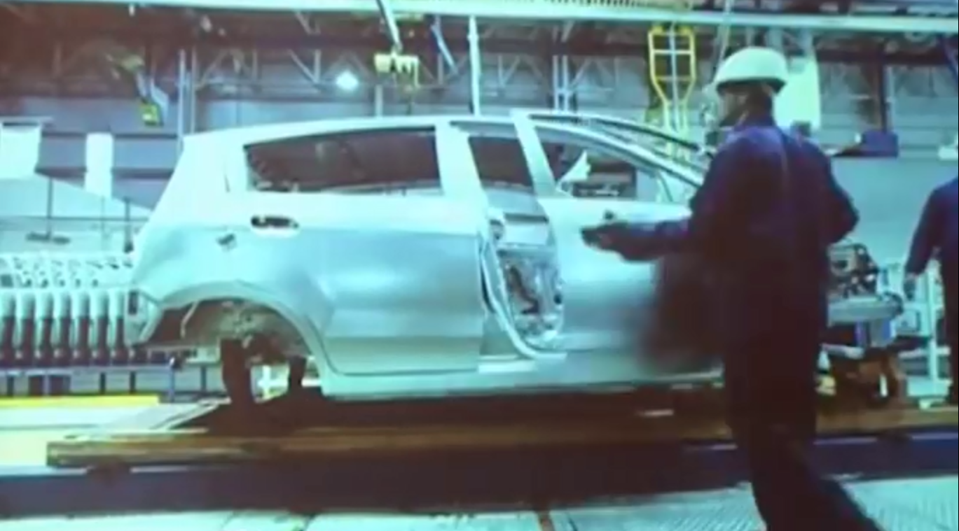
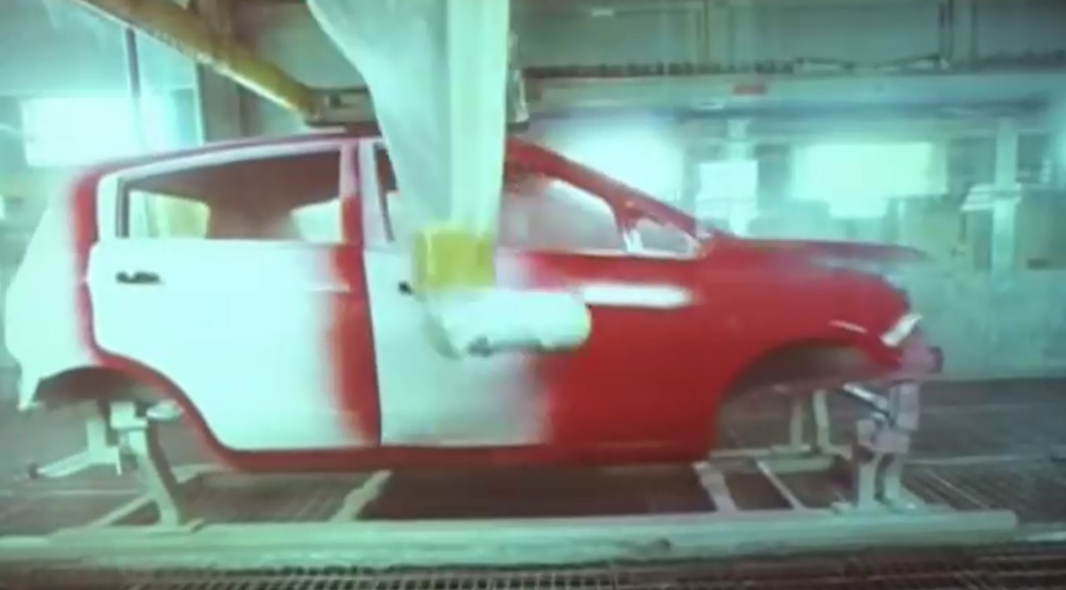
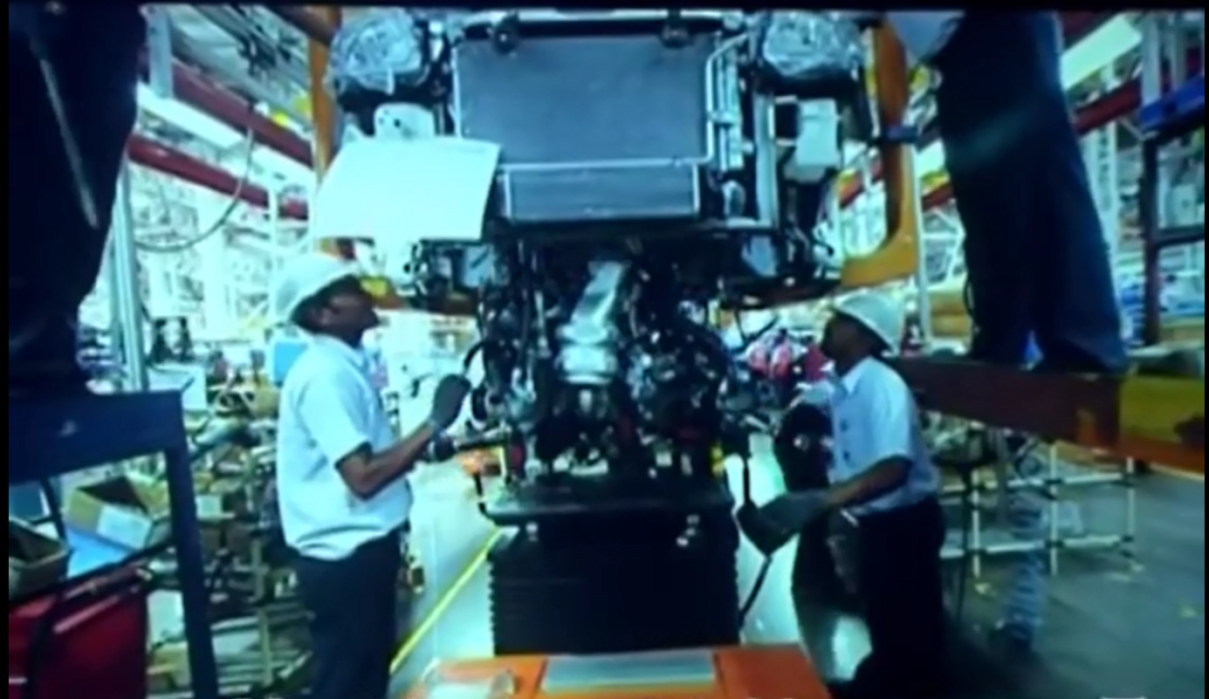
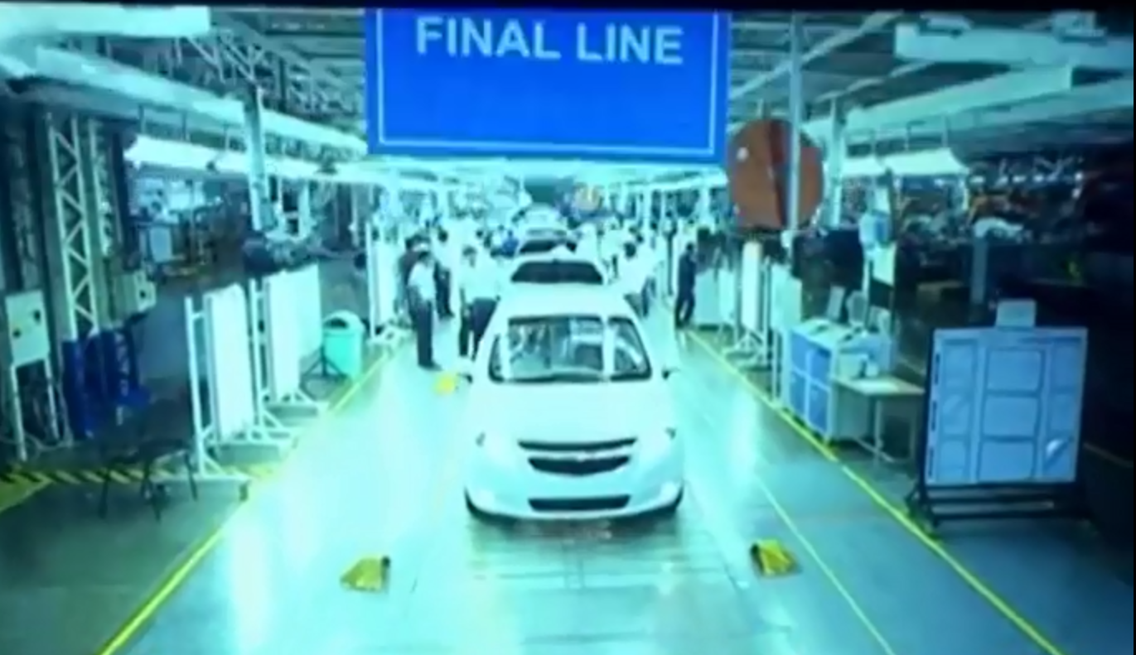
Spot Welding
Hemming
Stud Welding
Buffing
Projection Welding
Grinding
CO2 Welding
Dent pulling
Torquing
Reaming
Sealer application
Brazing
Job Per Hour Concept

Slide 4
Project Description
Expected Results :
To improve the HPU
Increment of the utilization from 79% to 90%
Increment of Value added work content from 59% to 62%
Reduce the over speeding from 25% to 11%
Project Topics :
Improvement through Time Study with the help of STDS Software
Productivity Improvement through:
Line Balancing Technique
Manpower Optimization
Implementation of Assembly Processing System (APS) Software Process
Study for the Implementation of New Models on Line
Downtime Monitoring
Reduce the Ergo rate of top rating stations
Objective
To Achieve Plant Internal Benchmark in Labor Productivity using the strategy of improving the HPU (Hours Per Unit).
How to Execute the Project :
To Increase % Value Addition
To Reduce Overspeed
To Increase Operator utilization

Slide 5
Standard Time Data System
&
1. Time Study Using STDS & MODE:
Manufacturing Operations Data Environment
Nearly 120+ operator's Standard Operation Sheet based on time study have been completed.
Namely of the following lines :
Dash M300
Engine Room SGM
Engine Room M300
Rear Floor SGM
Front Floor M300
Front Floor SGM
Rear Floor M300
Underbody SGM
Underbody M300
BIW Line
Side LH and RH M300
Closure Line SGM
Main Frame Line M300
Roof M300
Time Study involved the complete study of the respective station along with interaction with the Operators.

Slide 6
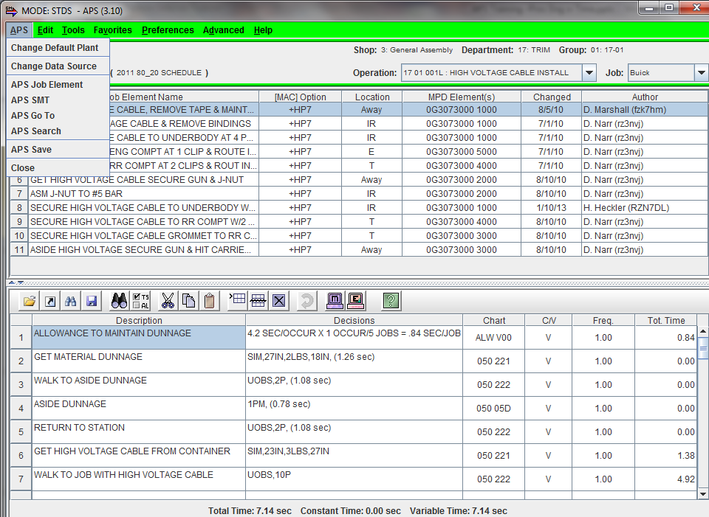
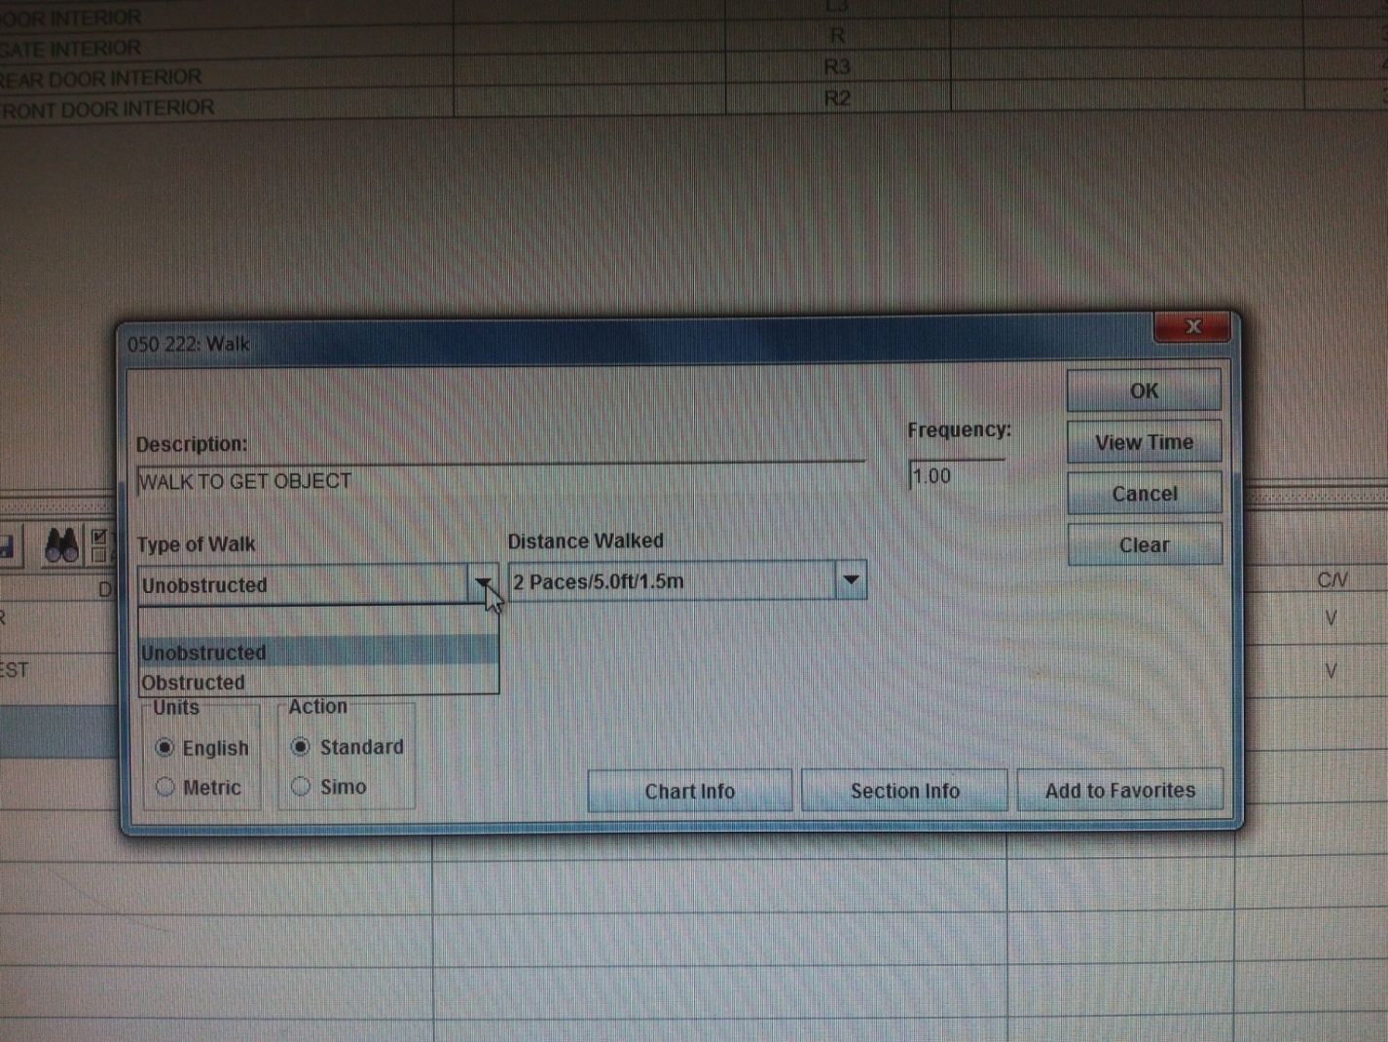
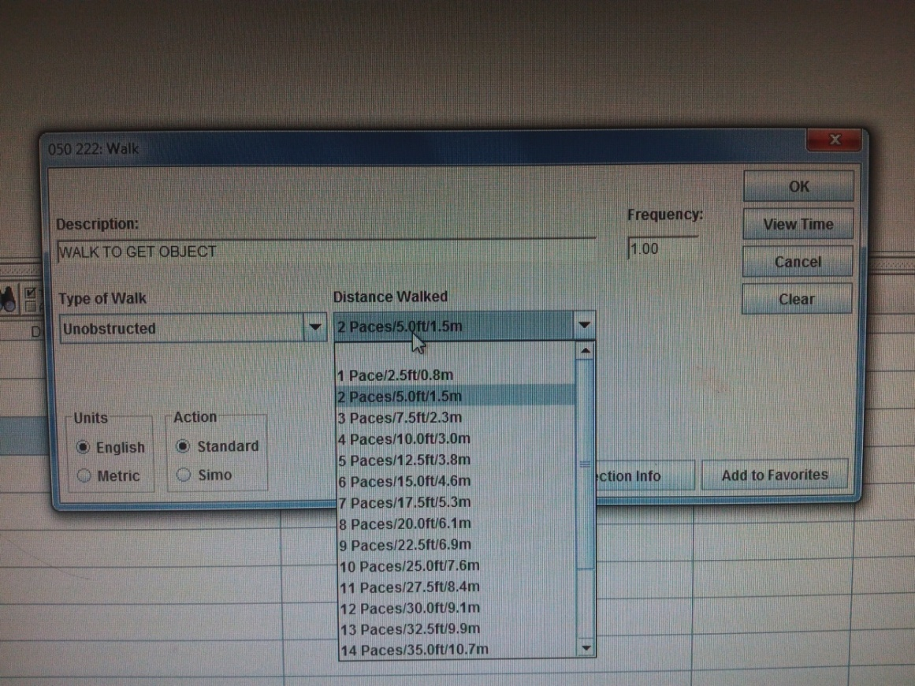
Chart Number: 050-222 (Walk)
Chart Includes:
Unobstructed Walk
Obstructed Walk
Walk with creform cart
Body turns in walk path
Chart Does Not Include:
Walking with or moving a bank of tools
Other Examples :
Chart 050-221 Get Object
Chart 001-031 Reposition Gun
Chart 001-011 Get Portable Spot welding Gun
Chart 050-224 Place Object to Fixture or Final Location

Slide 7
2.a. Productivity Improvement through Line Balancing :
Proposals : made on the basis of forecast study and high authority guidance
All these proposal's were accepted and successfully executed in the body shop.
Line’s re-balanced on the basis on the Time study for manpower optimization:
Engine Room SGM
Front and Rear Floor SGM
Underbody SGM
Engine Room M300
Front Floor M300
Rear Floor M300
Underbody M300
Closure SGM
AREA | PROPOSAL MADE
SGM | JPH Change from 6JPH/2Shifts to 2JPH/2Shifts
M300 | JPH Change from 18JPH/2S to 22JPH/2S
CLOSURES | Closures M300 JPH change from 15JPH/3S to 18JPH/3S AND Closures SGM JPH change from 6JPH/2S to 6JPH/1S
ROBOTS | Proposal of transferring Robots from Australia

Slide 8
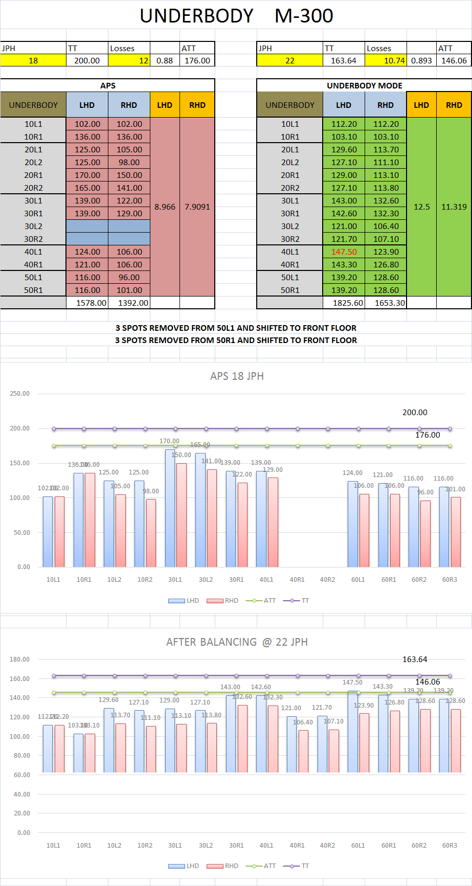
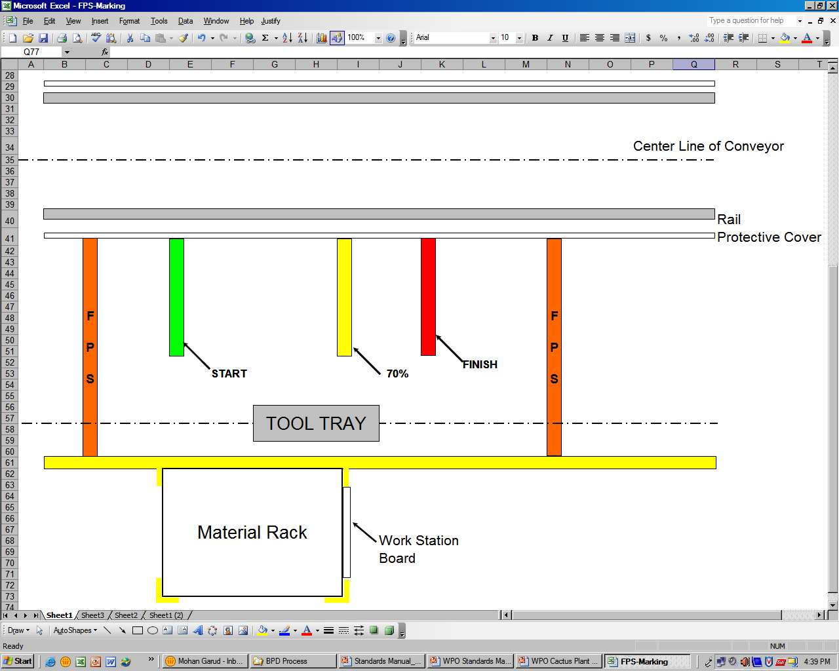
Line Balancing Calculations &Examples :

Slide 9
Front Floor
Line balancing : Front & Rear Floor (SGM)
SGM – 6 JPH
Rear Floor
#205
4
3
2
1
#210
#210
#220
6
5
#230
#220
Underbody

Slide 10
Front Floor
Line balancing : Front & Rear Floor (SGM)
SGM – 2 JPH
Rear Floor
#205
2
1
#210
#210
#220
#230
#220
Underbody

Slide 11
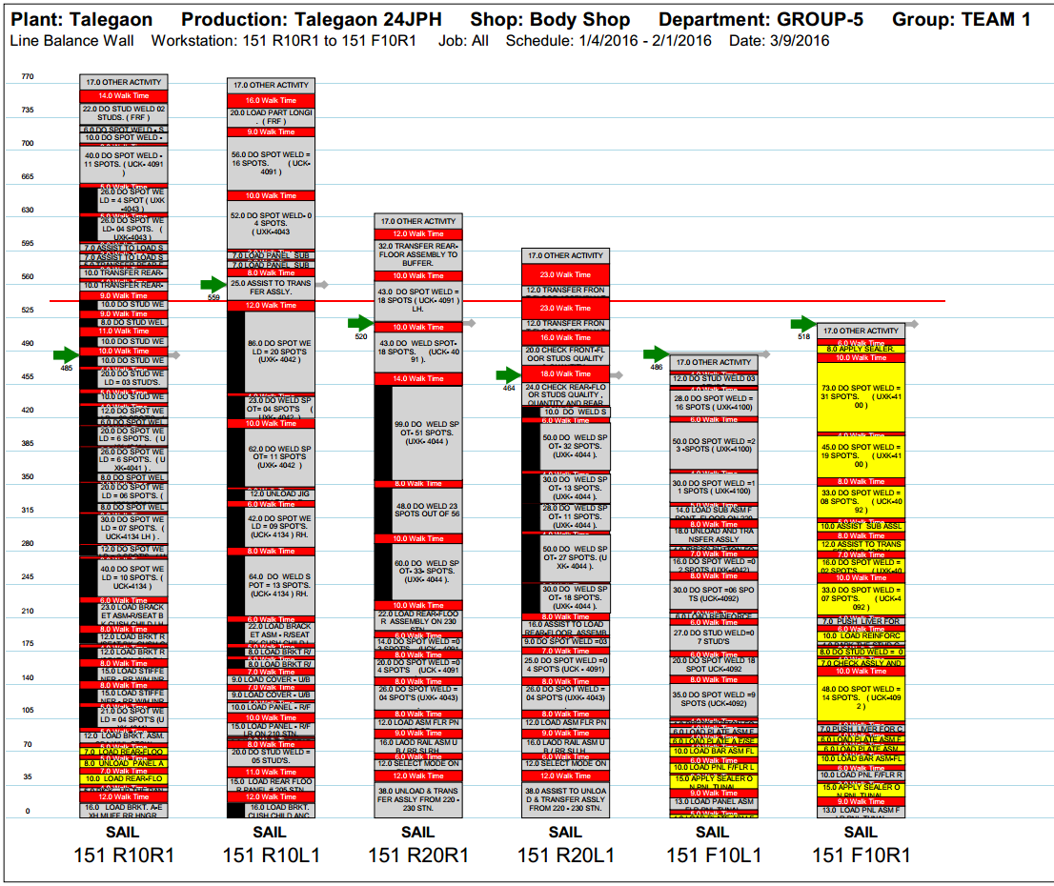
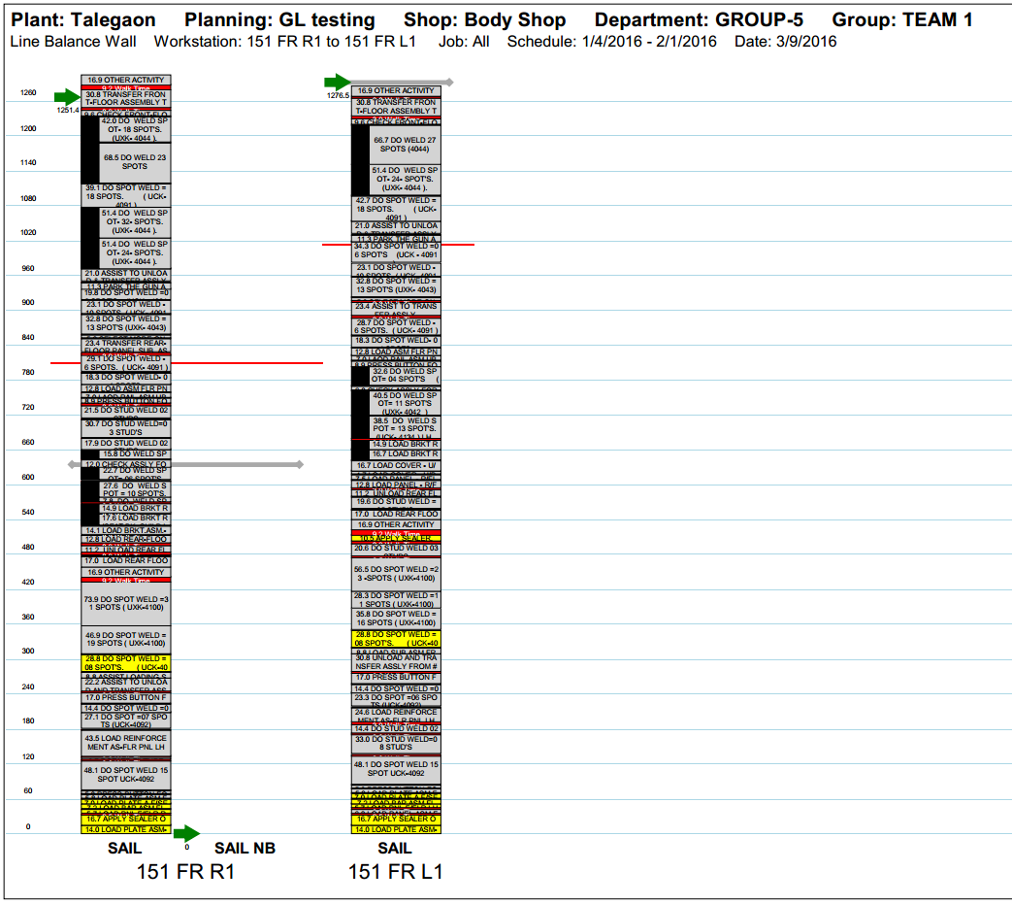
Front & Rear Floor (SGM) Balancing :
Before Line Balancing | After Line Balancing
After completing the Rear floor it has to be transferred from the station #230 of the Rear floor to the #210 station of the Underbody. This job only required one person for transferring. Due to this the other person gets into high ideal time. The similar case is when one person transfers the Front floor. | Later we proposed that the workmen will complete both the jobs at first and when one person is transferring Rear floor the other can transfer the Front floor and thus the Ideal time was considerably reduced.
During the Spot welding at the #205 station 5 studs are to be welded. As per the prior work content the workmen has to pick up one stud every time from the fixture #210 and walk back to #205 for stud welding | Instead of doing it 5 times the studs can be picked all at once and then the studs can be welded. Which reduced the walk time which is an non value added work
During the operation at fixture #205 the process only requires 1 person to do Stud welding where as there was a pre-activity to be performed before placing the Assembly from the #205 fixture to #210 fixture i.e. of placing a Muff at the #210 fixture. Prior the LH person use to first perform the stud welding and also secondly use to place the Muff whereas the RH person was only assisting and had high ideal time. | Now One person performs the Stud welding and the other performs the Placing activity simultaneously.

Slide 12
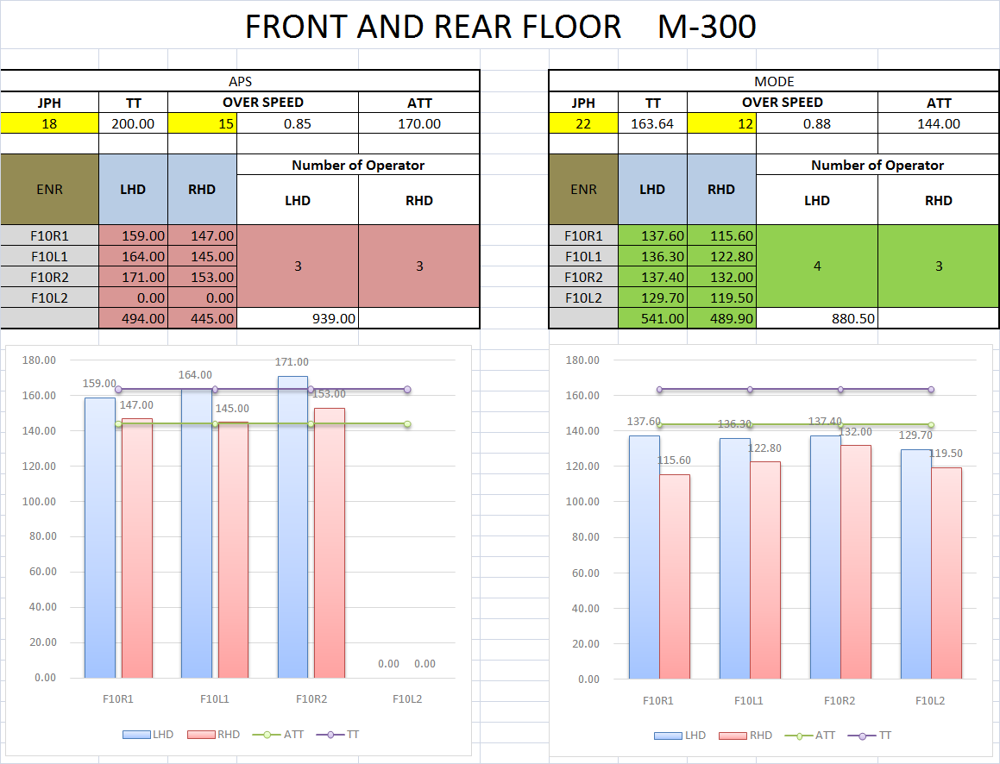
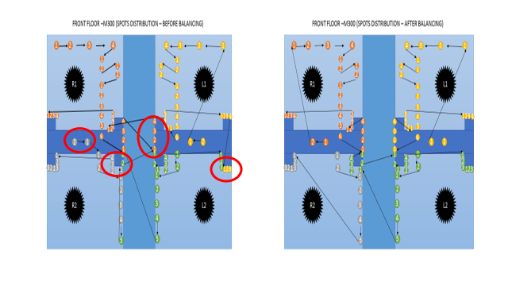
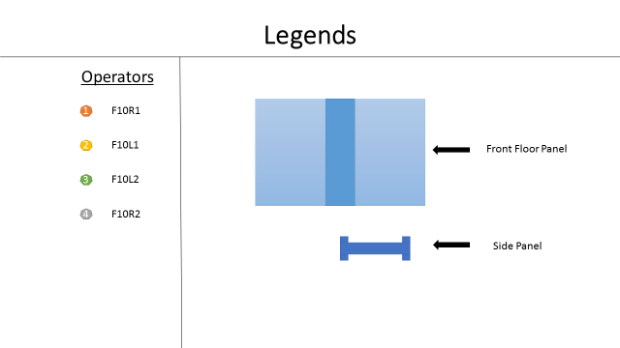
Front Floor M-300 Balancing :

Slide 13
2.b. Manpower Optimized :
Based on the Line balancing done an Overall Manpower Optimized was of 67 Manpower from which 51 were from Line balancing and the rest was from 12% Absenteeism and TL to Workmen ratio. Among 51, I had alone optimized 43 Manpower :
Removed | Re-deployed / Added | Total Benefit
11 (SGM area) / 1 shift | 8 (M300 area) / 1 shift | 18 / 2 shifts
6 (MFL M300 area) / 1 shift
25 (Closure Line ) |  | 25
 |  | 18 + 25 = 43 Manpower Optimized

Slide 14
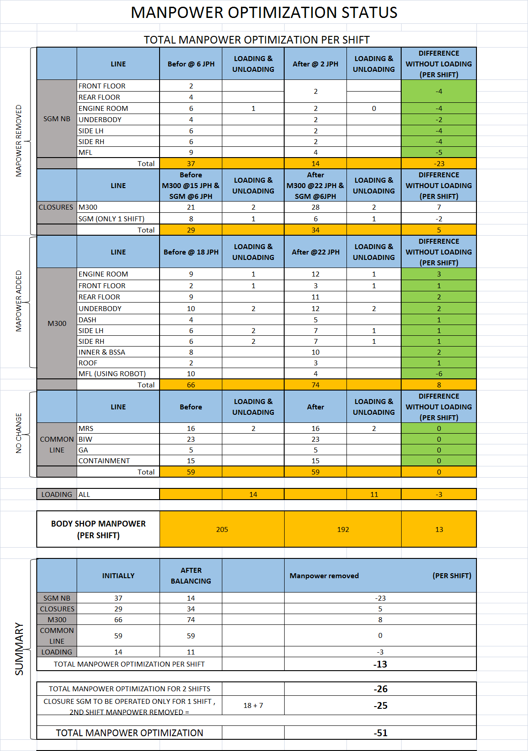

Slide 15
3. APS Deployment :
Assembly Processing System
Implementation for the Entire Body Shop i.e. for all 6 Groups on line by generating SOS and JES for each and every operator, as per the new balanced line.
Also generated Wall Charts and Scrolling of individual station’s. Also Providing training to Team Leaders for APS deployment.

Slide 16
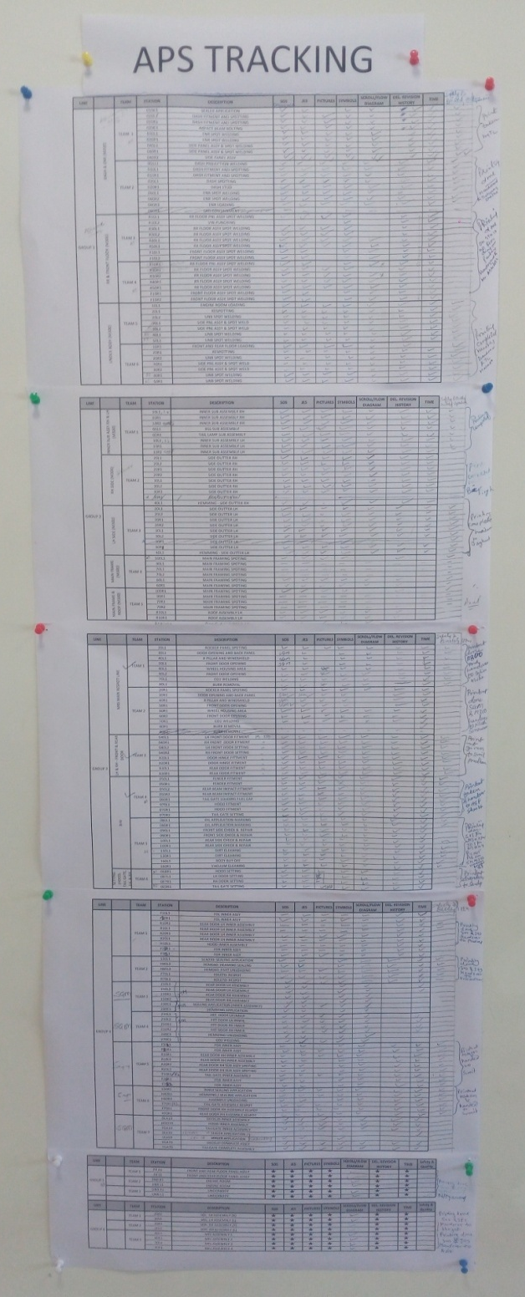
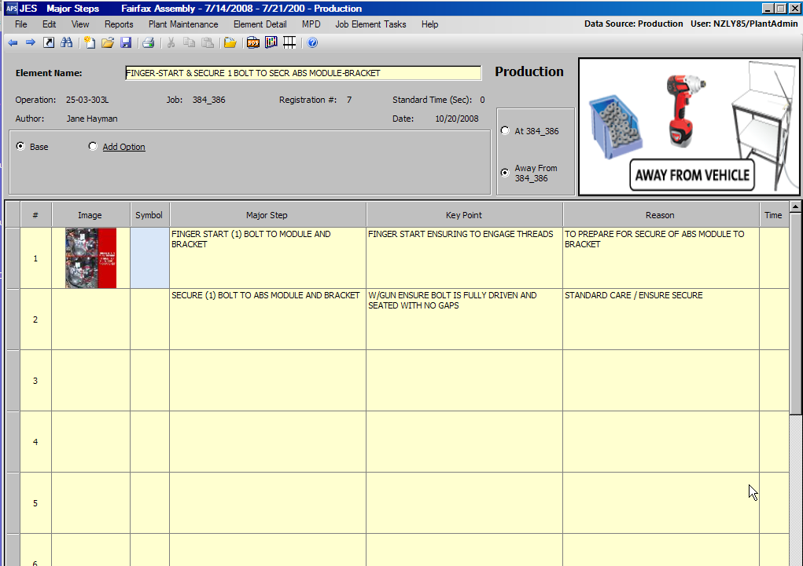
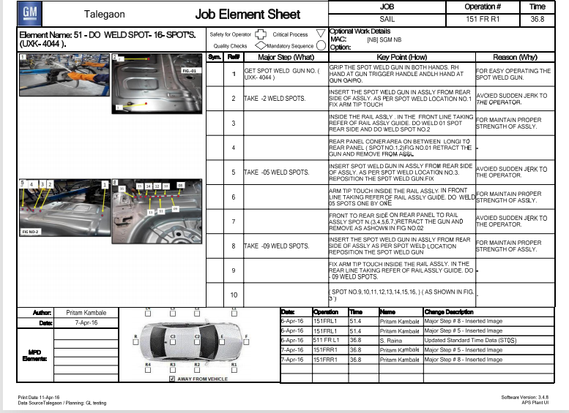
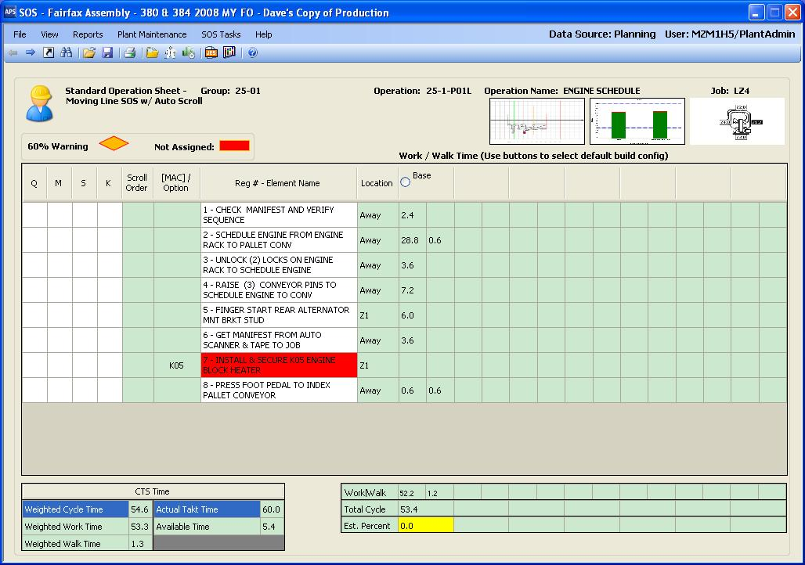
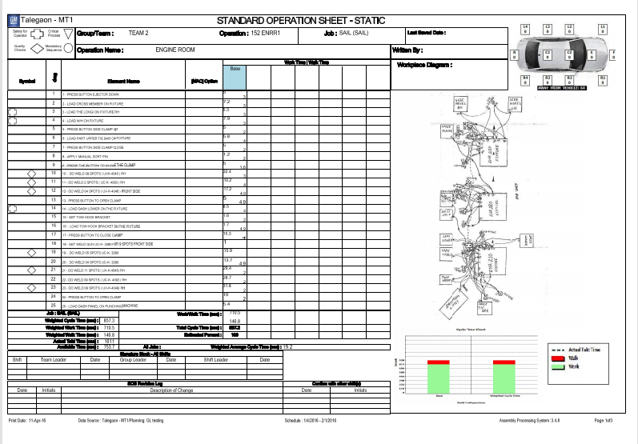

Slide 17
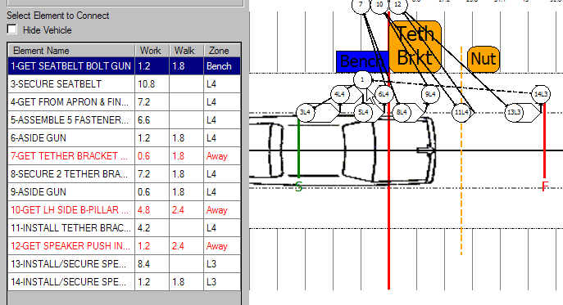
Scrolling
Wall Chart

Slide 18
4. Study of Implementation of New Models
Proposal made for an issue caused due to the changes done, at Main Respot Line (Common Line) was greatly appreciated for its cost free solution and has been approved for trial runs. This will reduce the work load at MRS line and the Line will thus get balanced.

Slide 19
Proposal :
Problem:
Some of the Spots has been Shifted from MRS line to MFL line (M300 Area) wherein 13 Robots have been added. So the Spots which had been taking place at MRS for M300 car now will be completed beforehand at MFL line (M300 Area).
But the situation is not same for SGM car. There have been no addition of Robots in the MFL line (SGM Area), because of which the spots for SGM have to be done at MRS line itself.
Solutions: Two Proposal's were given for this problem
Addition of a Weld Gun at MFL (SGM Area) which can take the same amount of spots similar to the spots shifted to MFL (M300 Area) can reduce the load at MRS line and thus can be one of the solution. But this proposal is not Cost effective as it takes cost of Weld gun at the particular site, also at MFL (SGM Area) the gun are very much congested, so the addition of a Weld Gun does not fulfill all the requirements.
As for M300, LHD to RHD Production ratio is 90% : 10% at 22 JPH where as for SGM, Only 100% RHD is produced at 2 JPH.
So every SGM car will be proceeded and followed by an RHD car. Thus the difference between the time for LHD - RHD will be utilized for SGM car.
This proposal is cost effective as well as it will not create any further problems. It can also be molded as per the JPH also.

Slide 20
5. Downtime Monitoring
By analyzing downtime and acknowledging the respective departments about their problematic areas, in terms of number of vehicle lost per day, the downtime has reduced and losses are being rectified.
Among the Two proposed report type for TIP board namely Station wise Report and 4M report , 4M report was approved and has been implemented on all Shop areas that are Body shop, Paint shop and General assembly shop along with Plant TIP board. The Report is currently in use and optimized efficiently.

Slide 21
Supporting content
Daily Report :
Weekly Report :
Monthly Report:
4M report:
Action Plan
4M
Man
Machine
Method
Material

Slide 22
Vehicle Losses :
Vehicle Losses | Jan | Feb | Mar | Apr
Body | 341.6 | 370.4 | 301.6 | 369.6
GA/ME/MAINT | 518.4 | 714.4 | 177.2 | 320.0
GSC | 280.0 | 137.6 | 533.6 | 225.2
IT/HR | 80.0 | 139.2 | 83.2 | 142.0
WFG | 0.0 | 0.0 | 55.6 | 52.8
Paint | 9.2 | 13.2 | 5.2 | 5.6
PE | 63.2 | 18.0 | 90.4 | 63.6
Press | 64.4 | 27.6 | 22.4 | 76.4
QE/SQA | 439.2 | 364.0 | 376.6 | 508.8
QO | 22.0 | 12.0 | 12.0 | 6.0
Scheduled Stop | 520.4 | 194.6 | 390.0 | 294.0
Total | 2338.4 | 1991 | 2047.8 | 2064
4 months downtime analyzing i.e. from Jan 2016 to April 2016.

Slide 23
Summary
% Target Achieved
Jan | 99.56%
Feb | 100.42%
Mar | 96.08%
Apr | 96.32%
 | Jan | Feb | Mar | Apr
Average Actual Production | 283.64 | 297.24 | 288.23 | 288.24

Slide 24
6. Ergonomics
Two High rated stations with Ergo issues were detected by GEST technique and solutions for them are being proposed.
Which will improve the efficiency the operator and reduce the work load.
Global Ergonomics Screening Tool

Slide 25
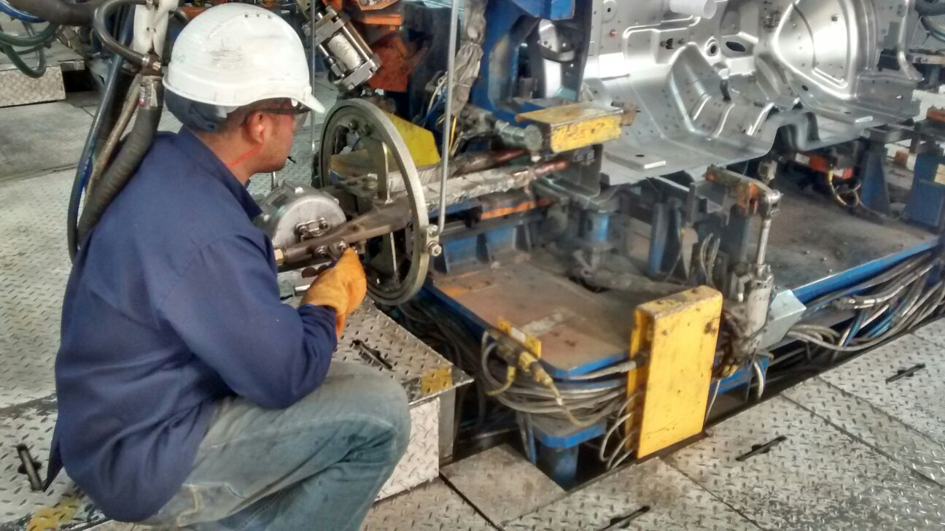
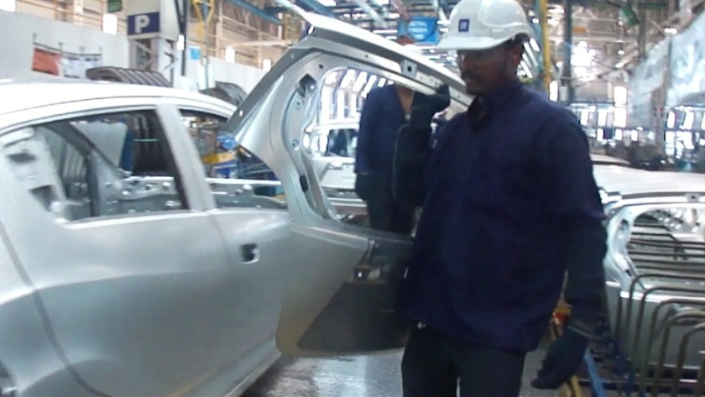
Proposal’s:
BIW 60 R
At this station the operator has to walk a considerable distance to get the tailgate and then to assemble it. The picture below shows the Ergo issue which illustrates the loading of heavy objects by carrying it by hand.
It was proposed that a rail supported hoist or tackle can be installed to transfer the tailgate.
ENR 230 L
At this station the operator has to bend down and perform 4 spots. The regular bending is an Ergo issue.
It was proposed that by transferring the spots to Underbody , the operator will be able to operate comfortably as the fixture is at an considerable height.

Slide 26
Future Scope

Slide 27
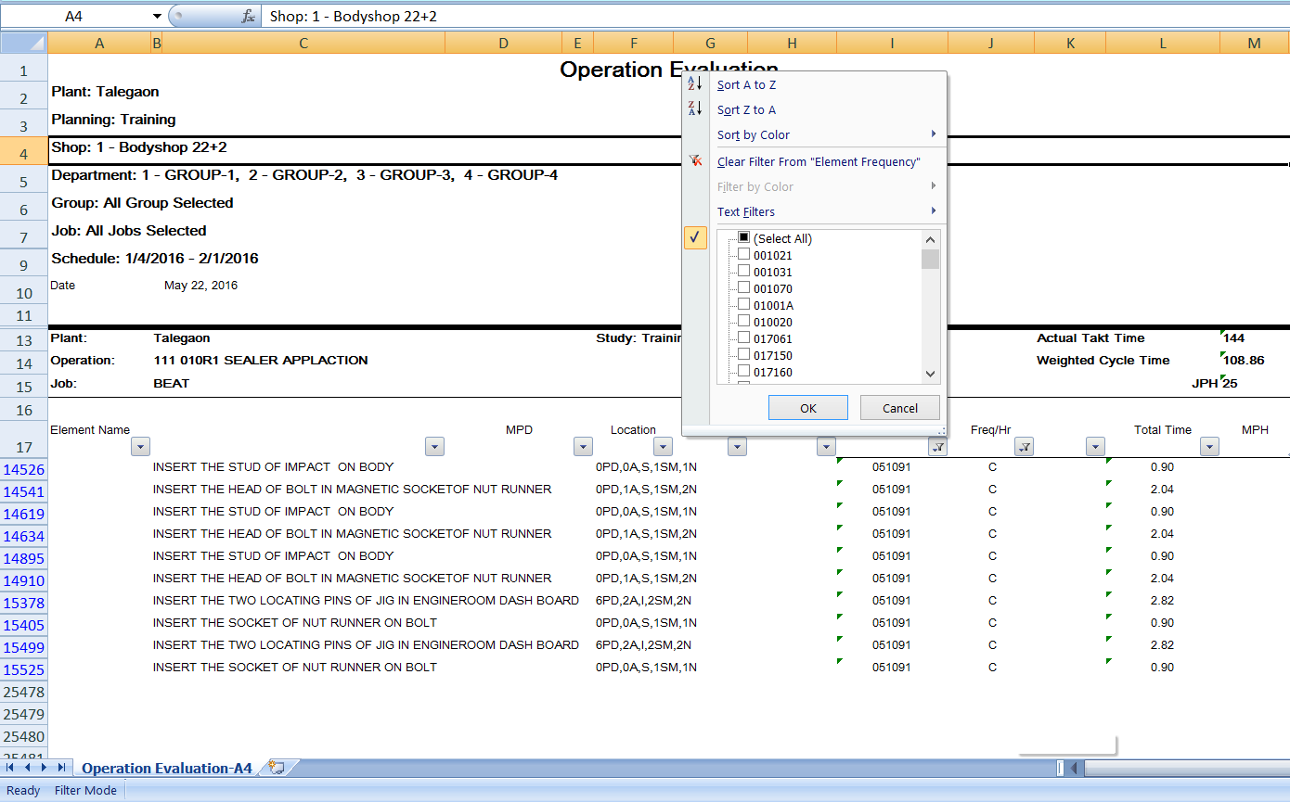
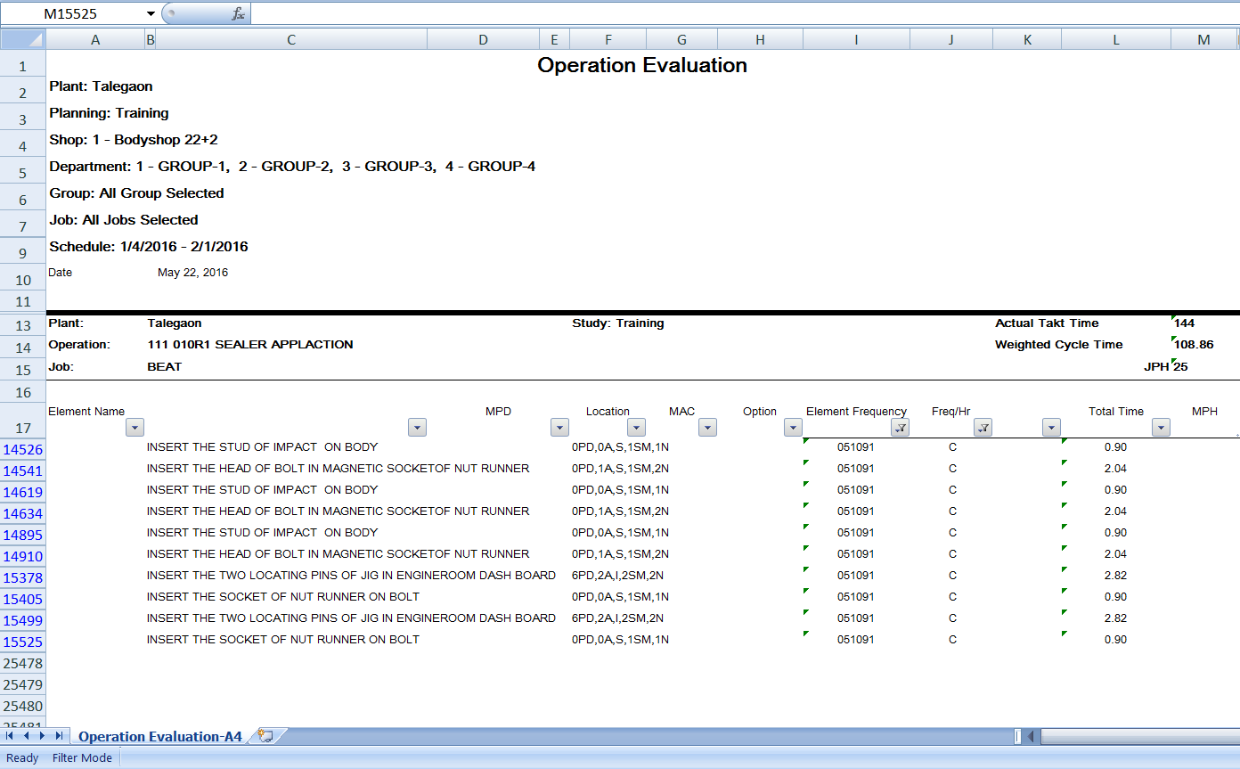
Research Work
The activities performed at the respective stations are differentiated based on the variability of the activity, that are constant activities and variable activities.
The data have been collected from throughout the Body Shop and tabulated as per the differentiation.
Based on the data collected, we can reduce the time constrained by variable activities using the techniques of Mathematical Modeling.
The result applying to the real life situation will profit all manufacturing companies following the standardization process.

Slide 28
Thank You

